Slide 2

Information SECURITY
AN INTRODUCTION

Slide 3
Cybersecurity is a way through which
one can protect one’s system from being exploited.
Hackers that help securing systems are known
as WHITE HAT hackers.
While the hackers exploiting the systems are known as BLACK HAT hackers.

Slide 4
Is it illegal? Yes/No
Is it moral? Mostly No
Can I go to jail? Yes
Is it fun? Hell yeah

Slide 5
Hacking Process
Main aim :
To gain root access to a system…

Slide 6
What do we get by doing this…???
Any Guess..??

Slide 7
Everything
Everything means everything…

Slide 8
Access any file in that system.
Open webcam
We can get all saved password. From browsers too.
Steal saved credit card information
Use his internet connection for our use ( yeah badsites too)
We can use his IP for doing bad activities.
Can change your attendance
Can use his computer for bitcoin mining
…….. and much more

Slide 9
Lastly
Most importantly clear logs and tracks
Example clear all terminal history by
Script kiddies: history -c -w
Hardcore
Microwave hard disk, then destroy by drilling

Slide 10
Fields
Web
Cryptography
Reversing
Mobile
Miscellaneous
Forensics

Slide 11
WEB SECURITY

Slide 12
SQL-Injection
SQL Injection (SQLi) is a type of an injection attack that makes it possible to execute malicious SQL statements. These statements control a database server behind a web application. Attackers can use SQL Injection vulnerabilities to bypass application security measures. They can go around authentication and authorization of a web page or web application and retrieve the content of the entire SQL database. They can also use SQL Injection to add, modify, and delete records in the database.

Slide 13
Let’s see some SQLi
https://portswigger.net/web-security/sql-injection/lab-login-bypass
https://ac951f0e1e37ff5180fee0b4005b0050.web-security-academy.net/

Slide 14
XSS - Cross Site Scripting
Cross-site scripting (XSS) is a type of computer security vulnerability typically found in web applications. XSS enables attackers to inject client-side scripts into web pages viewed by other users. A cross-site scripting vulnerability may be used by attackers to bypass access controls such as the same-origin policy.

Slide 15
Types of XSS
REFLECTED XSS
STORED XSS
DOM BASED XSS
<script>alert(“HACKED”)</script>

Slide 16
Let’s see some real time hacking
https://www.hackthebox.eu/invite

Slide 17
Cryptography
Cryptography is a method of protecting information and communications through the use of codes so that only those for whom the information is intended can read and process it.

Slide 18
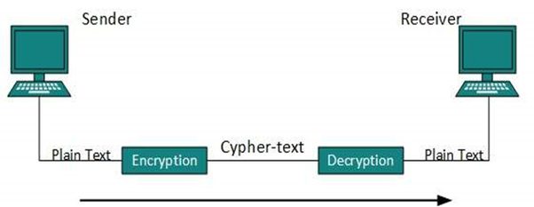

Slide 19
Encryption
A process to generate cipher text(unreadable message) from message with help of a key.
Decryption
A process to generate message from cipher text with help
of a key.

Slide 20
Two types of encryption:
Symmetric --- same key for encryption and decryption
Asymmetric --- different key for encryption and decryption

Slide 21
Encryption Algorithm
Ceaser cipher
simply each letter in the plaintext is shifted a certain number of places down the alphabet.
exercise cryptii.com
decode('Fvb hyl Ohjrlyz’)

Slide 22
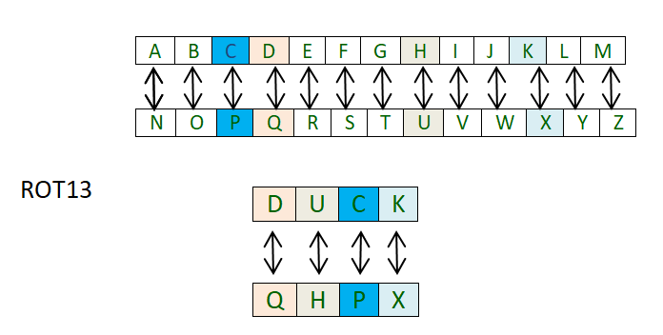

Slide 23
Vigenere cipher
Use a series of interwoven Caesar ciphers, based on the letters of a keyword.
Exercise https://planetcalc.com/2468/

Slide 24
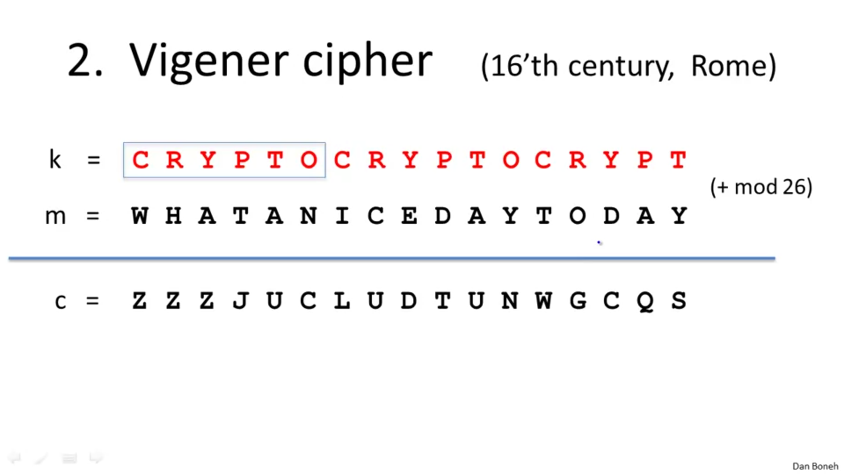

Slide 25
Can you decode this?
Zljbypaf pz hu pssbzpvu

Slide 26
Forensics
What is THIS?
Investigation and analysis techniques
Why it is used?
To gather and preserve evidence from a particular computing device

Slide 27
Can a JPEG Attack my Computer?
With the help of Steganography
It can be possible
But what is this?
Steganography is the technique of hiding secret data within an ordinary, non-secret, file or message in order to avoid detection;

Slide 28
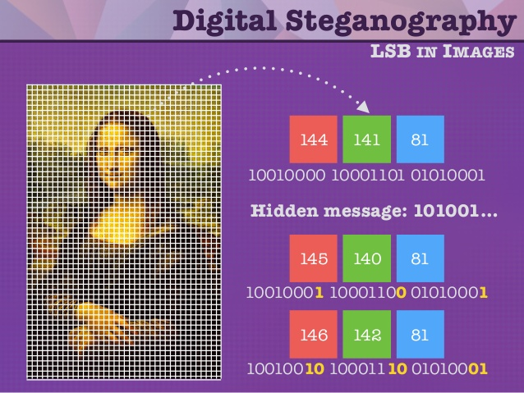
Changing the value of LSB(Least significant bit)

Slide 29
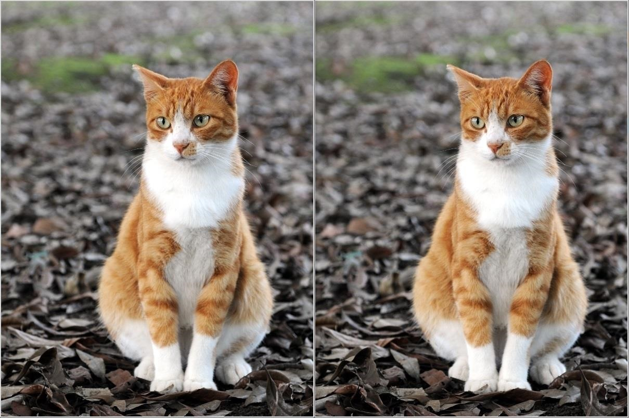
Can anyone tell the difference?
There is a secret message embedded in the 2nd picture

Slide 30
Our allies:
Linux (Kali)
Github
Google dorks
Online and offline tools
And of course, Firefox.

Slide 31
Frequently used tools:
Kali 2018.4
Firefox ( Best browser ); Chrome sucks ;(
Nmap- Network Scanning tool
Wireshark- Capture traffic
BurpSuite- Intercepts traffic

Slide 32
Thank You

